Slide 1

Department of CSE
(ARTIFICIAL INTELLIGENCE AND MACHINE LEARNING)
AUTOMATED TRAFFIC SIGNAL CONTROLLER
Under the Supervision of Prof. Pradeep Kumar K , Dr. Mude Nagarjuna Naik, Prof. Abhinav Karan
Assistant Professor, Artificial Intelligence & Machine Learning, SOE
Presented By:
Kasala Bhavana (ENG22AM0153)
Lakshya U Reddy (ENG22AM0169)
Nishat N Shahu (ENG22AM0184)
Tanya Gopal (ENG22AM0193)

Slide 2
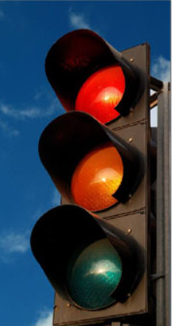
Overview
Introduction
Problem statement
Objectives
Project description
Methodology
Code implementation
Result and analysis
Conclusion

Slide 3
Introduction
The Automated Traffic Signal Controller Project seeks to revolutionize urban traffic management with a microcontroller-based system.
By integrating advanced algorithms and real-time data processing, it aims to enhance efficiency, safety, and sustainability in city transportation networks.
Aligned with smart city initiatives, the project emphasizes innovation and collaboration across disciplines to drive positive change in urban mobility
.

Slide 4
Problem Statement
Traditional traffic light systems often rely on manual operation or basic timer mechanisms, leading to suboptimal traffic management, increased congestion, and higher accident rates.
To tackle these challenges, the project endeavors to design and implement an intelligent traffic light controller system that dynamically adjusts signal timings based on real-time traffic conditions.
.

Slide 5
Objectives
Efficient Traffic Flow
Safety Enhancement
Optimized Intersection Management
Adaptability
Pedestrian Safety
Compliance with Regulations
Emergency Response Support
Energy Efficiency
Maintenance and Diagnostics
Integration with Intelligent Transportation Systems (ITS)
.

Slide 6
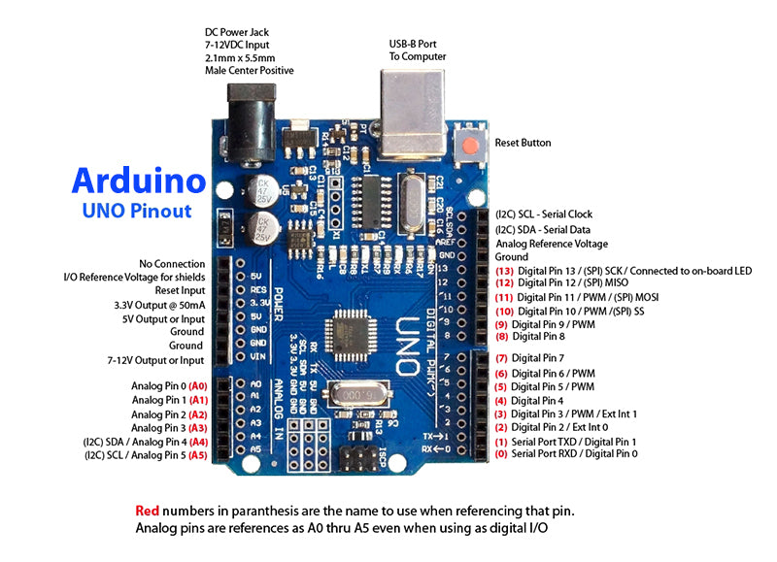
Project Description
Hardware Requirements:
Microcontroller Board
Sensors
LED Lights.
Power Supply Unit
Communication Modules
.

Slide 7
Project Description
Software Requirements:
Development Environment
Firmware/Software
Simulation Tools (Optional)
Remote Monitoring Software
.

Slide 8
Methodology
First, thorough requirement analysis is conducted to define both functional and non-functional requirements, considering factors like traffic volume, pedestrian crossings, and safety regulations. Hardware components are then carefully selected and set up, including microcontroller boards, sensors for vehicle and pedestrian detection, LED lights for traffic signals, and power supply units.
Following this, software development takes place, where firmware/software is created to implement automated traffic signal control logic, adaptive control algorithms, and features for emergency response support and energy efficiency optimization.
Once the hardware and software components are integrated, extensive testing is conducted to validate the system's functionality and performance under various traffic scenarios. This includes testing sensor accuracy, signal timing, pedestrian detection, and overall system reliability.
Optimization and fine-tuning are then performed to adjust signal timings, sensor thresholds, and control algorithms to achieve optimal traffic management objectives.
After optimization, the system is deployed at the target intersection, with proper installation and configuration. Remote monitoring capabilities are implemented to track system performance and receive real-time alerts for any issues. Ongoing monitoring and regular maintenance ensure the continued reliability and effectiveness of the automated traffic signal controller. Finally, comprehensive documentation and training are provided to relevant personnel for future reference and maintenance of the system.
.

Slide 9
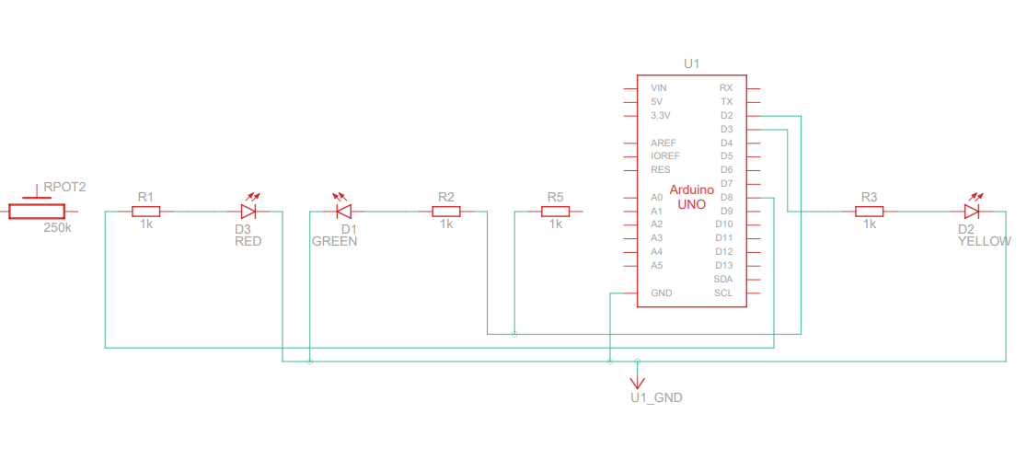
Circuit Diagram
.

Slide 10
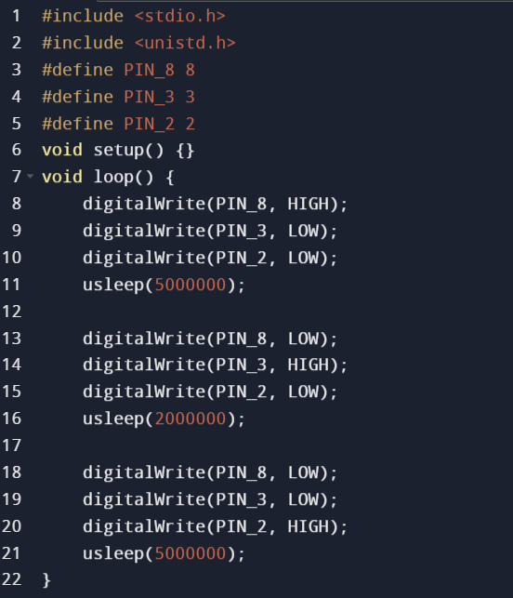

Code Implementation
.

Slide 11
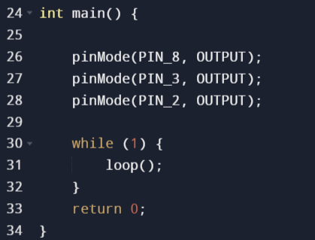
.

Slide 12
Result and analysis
Component: Traffic Signal Controller System
Action: Successfully initialize hardware components.
Process: Code initializes ports and pins, PLL for clock generation, and
timer
Analysis: Proper initialization ensures accurate sensor readings
and effective traffic management.
Component: Main Loop Execution
Action: Continuously monitor switch inputs.
Process: Code enters infinite loop, checks states of three switches, and
executes actions accordingly.
Analysis: Main loop handles real-time monitoring, enabling prompt
response to traffic changes.

Slide 13
Result and analysis
3. Component: Traffic Signal Control Logic
Action: Switch traffic lights based on switch inputs.
Process: Code implements control logic to adjust lights accordingly.
Analysis: Crucial for safe and efficient traffic operations at the intersection
4. Component: Delay and Timing Control
Action: Implement delay functions for precise timing control.
Process: delays ensure proper signal sequencing
Analysis: Essential for synchronization between signal phases

Slide 14
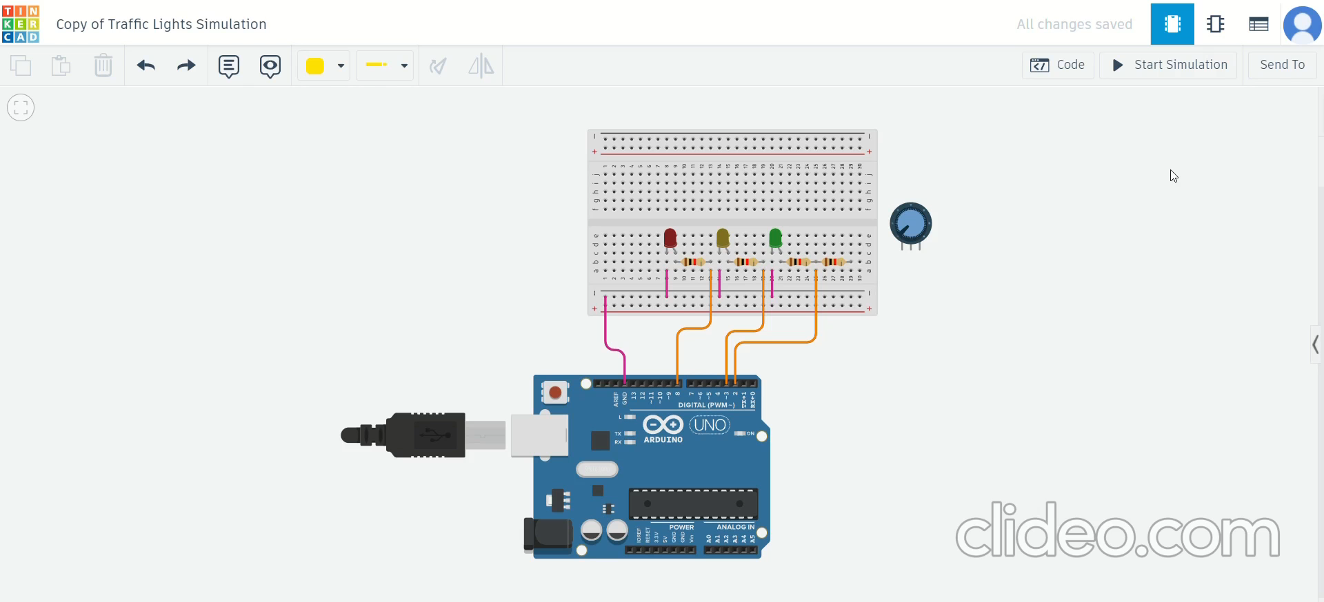
Stimulation

Slide 15
Conclusion
In conclusion, the provided code effectively implements an automated traffic signal controller using microcontroller-based hardware and software. It ensures proper initialization, continuous monitoring of traffic scenarios, precise signal control logic, and accurate timing coordination. This results in efficient traffic management, prioritized pedestrian safety, and adherence to regulations. The structured approach facilitates maintenance and future upgrades, laying a foundation for smarter urban transportation systems
.

Slide 16

.

